Slide 1
Types of Inheritance
Week 7 Lec 1 & 2

Slide 2
Types of Inheritance
Single Inheritance.
Multilevel Inheritance.
Multiple Inheritance.
Hierarchical Inheritance.
Hybrid Inheritance.

Slide 3
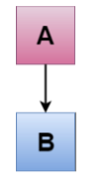
Single Inheritance
Single inheritance is defined as the inheritance in which a derived class is inherited from the only one base class. i.e. one sub class is inherited by one base class only.

Slide 4
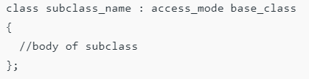
Syntax:

Slide 5
Single Level Inheritance Example: Inheriting Fields
#include <iostream>
using namespace std;
class Account {
public:
float salary = 60000; };
class Programmer: public Account {
public:
float bonus = 5000; };
int main(void) {
Programmer p1;
cout<<"Salary: "<<p1.salary<<endl;
cout<<"Bonus : "<<p1.bonus<<endl;
return 0; }

Slide 6
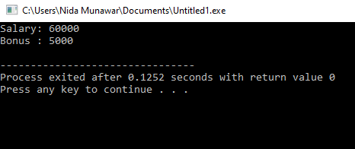
Output

Slide 7
OUTPUT?
#include <iostream>
using namespace std;
class Account {
public:
float salary = 60000; };
class Programmer: public Account {
public:
float bonus = 5000; };
int main(void) {
Account a1;
cout<<"Salary: "<<a1.salary<<endl;
cout<<"Bonus : "<<a1.bonus<<endl;
return 0; }

Slide 8
ERROR
#include <iostream>
using namespace std;
class Account {
public:
float salary = 60000; };
class Programmer: public Account {
public:
float bonus = 5000; };
int main(void) {
Account a1;
cout<<"Salary: "<<a1.salary<<endl;
cout<<"Bonus : "<<a1.bonus<<endl; //[Error] 'class Account' has no member named 'bonus'
return 0; }

Slide 9
C++ Single Level Inheritance Example: Inheriting Methods
#include <iostream>
using namespace std;
class Animal {
public:
void eat() {
cout<<"Eating..."<<endl;
}
};

Slide 10
C++ Single Level Inheritance Example: Inheriting Methods
class Dog: public Animal {
public:
void bark(){
cout<<"Barking..."; } };
int main(void) {
Dog d1;
d1.eat();
d1.bark();
return 0;
}

Slide 11
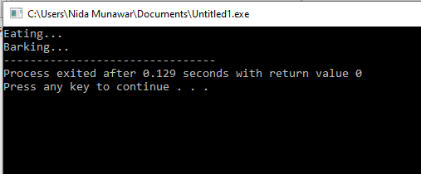
Output

Slide 12

Multilevel Inheritance
Multilevel inheritance is a process of deriving a class from another derived class.

Slide 13
Multilevel Inheritance
When one class inherits another class which is further inherited by another class, it is known as multi level inheritance in C++. Inheritance is transitive so the last derived class acquires all the members of all its base classes.
inheritance is transitive—a class not only inherits from its direct parent but also indirectly from its grandparent and beyond.
Notes:
if class B inherits from class A, and class C inherits from class B, then class C also indirectly inherits from class A.

Slide 14
Multi Level Inheritance Example
#include <iostream>
using namespace std;
class Animal {
public:
void eat() {
cout<<"Eating..."<<endl; } };
class Dog: public Animal {
public:
void bark(){
cout<<"Barking..."<<endl; } };

Slide 15
Multi Level Inheritance Example
class BabyDog: public Dog {
public:
void weep() {
cout<<"Weeping..."; } };
int main(void) {
BabyDog d1;
d1.eat();
d1.bark();
d1.weep();
return 0; }

Slide 16
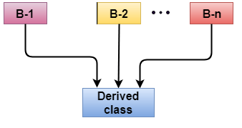
Multiple Inheritance
Multiple inheritance is the process of deriving a new class that inherits the attributes from two or more classes.

Slide 17
Syntax of the Derived class:
class D : visibility B-1, visibility B-2
{
// Body of the class;
}
Here, the number of base classes will be separated by a comma (‘, ‘) and access mode for every base class must be specified.

Slide 18
Multiple Inheritance Example
class A {
protected:
int a;
public:
void get_a(int n) {
a = n;} };
class B {
protected:
int b;
public:
void get_b(int n) {
b = n; } };

Slide 19
Multiple Inheritance Example
class C : public A,public B {
public:
void display() {
std::cout << "The value of a is : " <<a<< std::endl;
std::cout << "The value of b is : " <<b<< std::endl;
cout<<"Addition of a and b is : "<<a+b; } };
int main() {
C c;
c.get_a(10);
c.get_b(20);
c.display();
return 0;
}

Slide 20
Ambiguity Resolution in Inheritance
Ambiguity can be occurred in using the multiple inheritance when a function with the same name occurs in more than one base class.

Slide 21
Ambiguity Resolution in Inheritance
#include <iostream>
using namespace std;
class A {
public:
void display() {
std::cout << "Class A" << std::endl; } };
class B {
public:
void display() {
std::cout << "Class B" << std::endl; } };

Slide 22
Ambiguity Resolution in Inheritance
class C : public A, public B {
public:
void view() {
display(); } };
int main() {
C c;
c.view();
return 0; }

Slide 23
OUTPUT
[Error] reference to 'display' is ambiguous
The above issue can be resolved by using the class resolution operator with the function. In the above example, the derived class code can be rewritten as:

Slide 24
class C : public A, public B
{
public: void view()
{
A :: display(); // Calling the display() function of class A.
B :: display(); // Calling the display() function of class B.
}
};

Slide 25
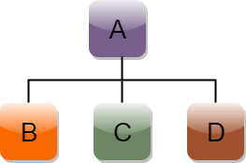
Hierarchical Inheritance
Hierarchical inheritance is defined as the process of deriving more than one class from a base class.

Slide 26
Syntax of Hierarchical inheritance:
class A
{
// body of the class A.
}
class B : public A
{
// body of class B.
}
class C : public A
{
// body of class C.
}
class D : public A
{
// body of class D.
}

Slide 27
Example
#include <iostream>
using namespace std;
class Shape // Declaration of base class.
{ public:
int a;
int b;
void get_data(int n,int m) {
a= n;
b = m; }
};

Slide 28
Example
class Rectangle : public Shape{ // inheriting Shape class
public:
int rect_area() {
int result = a*b;
return result; } };
class Triangle : public Shape { // inheriting Shape class
public:
int triangle_area() {
float result = 0.5*a*b;
return result; } };

Slide 29
Example
int main() {
Rectangle r;
Triangle t;
int length,breadth,base,height;
cin>>length>>breadth;
r.get_data(length,breadth);
int m = r.rect_area();
std::cout << "Area of the rectangle is : " <<m<< std::endl;
cin>>base>>height;
t.get_data(base,height);
float n = t.triangle_area();
std::cout <<"Area of the triangle is : " << n<<std::endl;
return 0; }

Slide 30
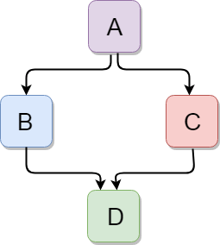
C++ Hybrid Inheritance
Hybrid inheritance is a combination of more than one type of inheritance.

Slide 31
Example
#include <iostream>
using namespace std;
class A {
protected:
int a;
public:
void get_a() {
std::cout << "Enter the value of 'a' : " << std::endl;
cin>>a; } };

Slide 32
Example
class B : public A {
protected:
int b;
public:
void get_b() {
std::cout << "Enter the value of 'b' : " << std::endl;
cin>>b; } };

Slide 33
Example
class C : public A {
protected:
int c;
public:
void get_c() {
std::cout << "Enter the value of c is : " << std::endl;
cin>>c; } };

Slide 34
Example
class D : public B, public C {
protected:
int d;
public:
void mul() {
get_a();
get_b();
get_c();
std::cout << "Multiplication of a,b,c is : " <<a*b*c<< std::endl; } };

Slide 35
Example
int main() {
D d;
d.mul();
return 0; }

Slide 36
When static members are inherited, are they static for the entire hierarchy, or just that class?
class SomeClass{
public:
static int total;
SomeClass() {
total++;}
void Print(string n) { cout << n << ".total = " << total << endl; }};
int SomeClass::total = 0;
class SomeDerivedClass: public SomeClass{
public:
SomeDerivedClass() {total++;}};

Slide 37
int main(int argc, char ** argv){
SomeClass A;
SomeClass B;
SomeDerivedClass C;
A.Print("A");
B.Print("B");
C.Print("C");
return 0;}

Slide 38
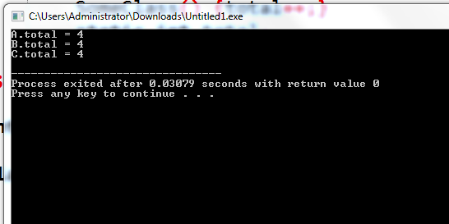
Notes:
O/p is 4 bcz base const calls when derived class runs

Slide 39
When static members are inherited in C++
When static members are inherited in C++, they remain shared across the entire hierarchy. This means that there is only one copy of the static member, regardless of how many derived classes or instances exist.
Static members belong to the class, not an instance
A static member is shared among all instances of the class.
Even when inherited, it remains associated with the base class.
Inheritance of Static Members
A derived class inherits the static member but does not create a new copy.
Both the base and derived class refer to the same single instance of the static member.

Slide 40
When static members are inherited in C++
#include <iostream>
using namespace std;
class Base {
public:
static int staticVar; // Shared across the hierarchy
};
class Derived : public Base {};
int Base :: staticVar;
int main() {
cout << "Base::staticVar: " << Base::staticVar << endl;
cout << "Derived::staticVar: " << Derived::staticVar << endl;
Derived::staticVar = 20;
cout << "After modifying Derived::staticVar" << endl;
cout << "Base::staticVar: " << Base::staticVar << endl;
cout << "Derived::staticVar: " << Derived::staticVar << endl;
return 0;
}

Slide 41
Task
Create a class named MusicalComposition that contains fields for title, composer, and year written(attribute a only accessible by its subclass). Include a setter function that requires all three values and an appropriate display function. The child class NationalAnthem contains an additional field that holds the name of the anthem’s nation. The child class setter requires a value for this additional field. The child class also contains a display function. Write a main() function that instantiates object of subclass and call both display functions .

Slide 42
Solution
#include <iostream>
#include <String>
#include<ios> //used to get stream size
#include<limits> //used to get numeric limits
using namespace std;
class MusicComposition {
protected:
string title,compose;
int year;
public:
void setA(){
cout << "enter title"<< endl;
getline(cin ,title);
cout << "composer"<< endl;
getline(cin ,compose);
cout << "enter year"<< endl;
cin >> year;
}

Slide 43
Solution
void display() {
cout << title << compose << year <<endl; } };
class NationalAnthem : public MusicComposition{
public:
string name;
void setB(){
cout << "enter name"<< endl;
cin.ignore(numeric_limits<streamsize>::max(), '\n'); //clear buffer before taking new line
getline(cin ,name);
}
void display() {
cout << name << endl; } };

Slide 44
Solution
int main() {
NationalAnthem n;
n.setA() ;
n.setB();
n.MusicComposition::display();
n.display();
return 0; }

Slide 45
Constructors and Destructors in Derived Classes
When we construct a derived class object, the base object must be created first. If we do not specify any base-constructor, it calls a base-constructor. This is because the base-constructor does initialization of derived object's the inherited base-class member. The members of derived object are initialized by the derived-constructor.
Invocation of constructors and destructors depends on the type of inheritance being implemented.

Slide 46
Constructors and Destructors in Derived Classes
instantiating a derived-class object begins a chain of constructor calls in which the derived-class constructor, before performing its own tasks, invokes its direct base class’s constructor either explicitly (via a base-class member initializer) or implicitly (calling the base class’s default constructor). Similarly, if the base class is derived from another class, the base-class constructor is required to invoke the constructor of the next class up in the hierarchy, and so on. The last constructor called in this chain is the constructor of the class at the base of the hierarchy, whose body actually finishes executing first. The original derived-class constructor’s body finishes executing last. Each base-class constructor initializes the base-class data members that derived-class object inherits.

Slide 47
Constructor and destructor in single inheritance
#include <iostream>
using namespace std;
class A{
public:
A() { cout << "A()" << endl; }};
class B : public A{
public:
B() { cout << "B()" << endl; }}; // BY DEFAULT B() : A()
int main(){
B b;
return 0;
}

Slide 48
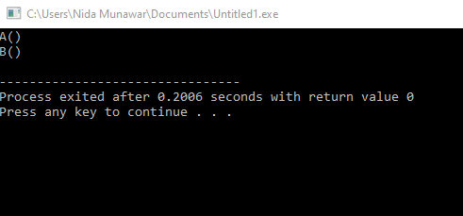
Constructor and destructor in single inheritance
Remember, a derived-class constructor always calls a base-class constructor. The base-class object should be constructed before the code enters the body of the derived-class constructor.

Slide 49
Important points
Whenever the derived class’s default constructor is called, the base class’s default constructor is called automatically.
To call the parameterized constructor of base class inside the parameterized constructor of sub class, we have to mention it explicitly.
The parameterized constructor of base class can be called in default constructor of sub class

Slide 50
#include <iostream>
using namespace std;
class A{
protected:
int ia;
public:
A(int n) : ia(n) { cout << "A()" << endl; }};
class B : public A{
int ib;
public:
B(int n) : ib(n) { cout << "B()" << endl; }}; //[Error] no matching function for call to 'A::A()'
int main(){
B b(2);
return 0;}

Slide 51
#include <iostream>
using namespace std;
class A{
protected:
int ia;
public:
A(int n) : ia(n) { cout << "A()" << endl; }};
class B : public A{
int ib;
public:
B(int n) : ib(n) { cout << "B()" << endl; }}; //[Error] no matching function for call to 'A::A()’
int main(){
A a (3);
B b(2);
return 0;}

Slide 52
The parameterized constructor of base class can be called in default constructor of sub class
#include <iostream>
using namespace std;
class A{
protected:
int ia;
public:
A(int n) : ia(n) { cout << "A()" << endl; }};
class B : public A{
int ib;
public:
B() : A(3) { cout << "B()" << endl; }};
int main(){
B b;
return 0;}

Slide 53
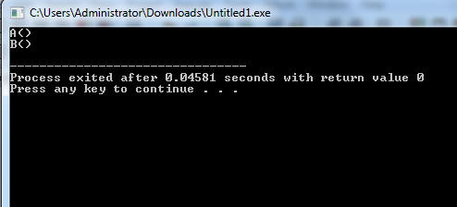

Slide 54
Parametrized Base Constructor with default value
#include <iostream>
using namespace std;
class A{
protected:
int ia;
public:
A(int n=1) : ia(n) { cout << "A()" << endl; }};
class B : public A{
int ib;
public:
B(int n) : ib(n) { cout << "B()" << endl; }};
int main(){
B b(2);
return 0;}

Slide 55
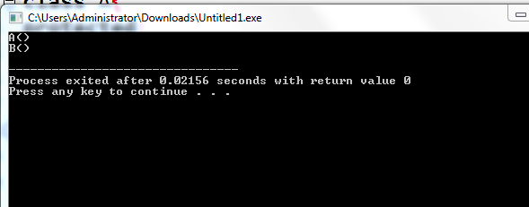

Slide 56
Parametrized Base Constructor
If we need to initialize inherited the base-class member with different value form a default value, we can use base-class constructor in the initializer list of the derived-class constructor
Derived class constructor(arg1,arg2) : base(arg1){
derived= arg2;} // order of arguments doesn't matter
OR
Derived class constructor(arg1,arg2) : base(arg1) , derived(arg2){}
OR
Derived class constructor(arg1) : base(any value) , derived(arg1){}

Slide 57
Parametrized Base Constructor(order does not matter)
#include <iostream>
using namespace std;
class A{
public:
A(int n = 1) : ia(n)
{ cout << "A() ia = " << ia << endl; }
protected:
int ia;};
class B : public A{
int ib;
public:
B(int n , int a) : ib(n), A(a)
{ cout << "B()" << endl; } };
int main(){
B b(2 ,4);
return 0;}

Slide 58
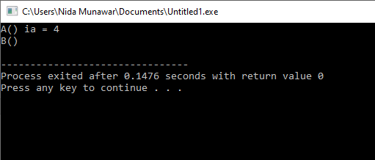
Parametrized Base Constructor

Slide 59
Parametrized Base Constructor(with same val)
#include <iostream>
using namespace std;
class A{
public:
A(int n) : ia(n)
{ cout << "A() ia = " << ia << endl; }
protected:
int ia;};
class B : public A{
int ib;
public:
B(int n) : ib(n), A(n)
{ cout << "B() ib =" << ib << endl; } };
int main(){
B b(2);
return 0;}

Slide 60
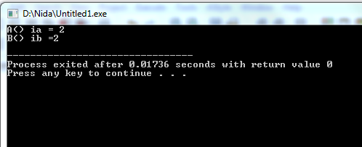
Parametrized Base Constructor

Slide 61
Constructor and destructor in Hierarchical inheritance
#include <iostream>
using namespace std;
class A{
public:
A() { cout << "A()" << endl; }};
class B : public A{
public:
B() { cout << "B()" << endl; } };
class C : public A{
public:
C() { cout << "C()" << endl; } };
int main(){
B b;
C c;
return 0;}

Slide 62
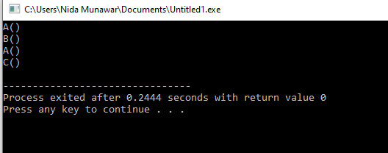
Constructor and destructor in Hierarchical inheritance

Slide 63
#include <iostream>
using namespace std;
class A{
public:
A() { cout << "A()" << endl; }};
class B : public A{
public:
B() { cout << "B()" << endl; } };
class C : public A{
public:
C() { cout << "C()" << endl; } };
int main(){
B b;
C c;
return 0;}

Slide 64
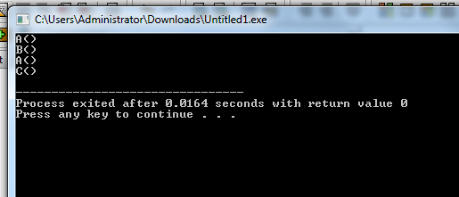

Slide 65
Constructor and destructor in multiple inheritance
Constructors from all base class are invoked first and the derived class constructor is called.
Order of constructor invocation depends on the order of how the base is inherited.
For example:
class C :public A , public B

Slide 66
Constructor and destructor in multiple inheritance
Here, A is inherited first, so the constructor of class A is called first and then constructor of class B is called next.
However, the destructor of derived class is called first and then destructor of the base class which is mentioned in the derived class declaration is called from last towards first in sequentially.

Slide 67
Syntax
Derived class constructor(arg1,arg2,arg3) : base1(arg1) , base2(arg2){
derived= arg3;}
OR
Derived class constructor(arg1,arg2,arg3) : base1(arg1) , base2(arg2), derived(arg3){}

Slide 68
Constructor and destructor in multiple inheritance
class A{
public: A(int a) { cout << "A()" << a << endl; }};
class B{
public: B(int b ){ cout << "B()" << b << endl; } };
class C :public A , public B{
public:
int m;
C(int x, int y, int z): A(x) , B(y) ,m(z){
cout<< "C()" << m << endl;}};
int main(){
C c(2,4,6);
return 0;}

Slide 69
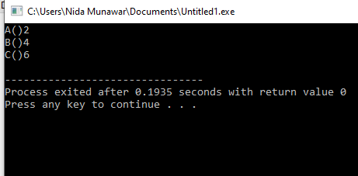
Constructor and destructor in multiple inheritance

Slide 70
#include <iostream>
using namespace std;
class A {
public:
A() { cout << "Constructor of A" << endl; }
~A() { cout << "Destructor of A" << endl; }
};
class B {
public:
B() { cout << "Constructor of B" << endl; }
~B() { cout << "Destructor of B" << endl; }
};
class C : public A, public B { // A is inherited first, then B
public:
C() { cout << "Constructor of C" << endl; }
~C() { cout << "Destructor of C" << endl; }
};
int main() {
C obj;
return 0;
}

Slide 71
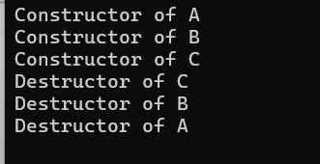

Slide 72
Constructor and destructor in multi level inheritance
class A{
public:
A() { cout << "A()" << endl; }};
class B : public A{
public:
B() { cout << "B()" << endl; } };
class C : public B{
public:
C() { cout << "C()" << endl; } };
int main(){
C c;
return 0;}

Slide 73
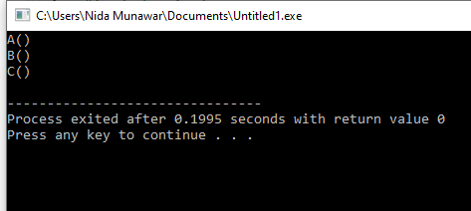
Constructor and destructor in multi level inheritance

Slide 74
#include <iostream>
using namespace std;
class A {
public:
A() { cout << "A()" << endl; }
~A() { cout << "~A()" << endl; } // Destructor
};
class B : public A {
public:
B() { cout << "B()" << endl; }
~B() { cout << "~B()" << endl; } // Destructor
};
class C : public B {
public:
C() { cout << "C()" << endl; }
~C() { cout << "~C()" << endl; } // Destructor
};
int main() {
C c;
return 0;
}

Slide 75
You can not directly call indirect parent(A) constructor in C
class A{
public:
A(int a) { cout << "A()" << endl; }};
class B : public A{
public:
B(int b) :A(b){ cout << "B()" << endl; } };
class C : public B{
public:
C():B(3) { cout << "C()" << endl; } };
int main(){
C c;
return 0;}

Slide 76
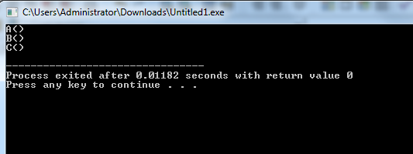

Slide 77
#include <iostream>
using namespace std;
class A{
public:
A(int a) { cout << "A()" << endl; }};
class B : public A{
public:
B(){ cout << "B()" << endl; } };
class C : public B{
public:
C():A(3) { cout << "C()" << endl; } }; //error
int main(){
C c;
return 0;}

Slide 78
#include <iostream>
using namespace std;
class A{
public:
A(int a) { cout << "A()" << endl; }};
class B : public A{
public:
B():A(2){ cout << "B()" << endl; } };
class C : public B{
public:
C() { cout << "C()" << endl; } }; //error
int main(){
C c;
return 0;}

Slide 79
#include <iostream>
using namespace std;
class A {
public:
A(int a) { cout << "A(" << a << ")" << endl; }
};
class B : public A {
public:
B(int a, double b) : A(a) { cout << "B(" << b << ")" << endl; }
};
class C : public B {
public:
C(int a, double b, char c) : B(a, b) { cout << "C(" << c << ")" << endl; }
};
int main() {
C c(1, 2.5, 'X');
return 0;
}

Slide 80
Task
Create a class named A include a constructor that accepts one parameter(any type) , create another class named B that inherits from A also include a constructor that accepts one parameter(any type) , create a class named C that inherits from B having a constructor that accepts one parameter now initialize all base class constructors through the child classes
Remember if the base class is derived from another class, the base-class constructor is required to invoke the constructor of the next class up in the hierarchy

Slide 81
Solution
#include <iostream>
using namespace std;
class A{
public:
A(int a=1) { cout << "A()" << a << endl; }};
class B : public A{
public:
B(int b , int valA ):A(valA) { cout << "B()" << b << endl; } };
class C : public B{
public:
C(int c ,int valB):B(valB ,6) { cout << "C()" <<c << endl; } };
int main(){
C c(2,4);
return 0;}

Slide 82
Solution
#include <iostream>
using namespace std;
class A{
public:
A(int a=1) { cout << "A()" << a << endl; }};
class B : public A{
public:
B(int b , int valA ):A(valA) { cout << "B()" << b << endl; } };
class C : public B{
public:
C(int c ,int valB, int ia):B(valB ,ia) { cout << "C()" <<c << endl; } };
int main(){
C c(2,4,6);
return 0;}

Slide 83
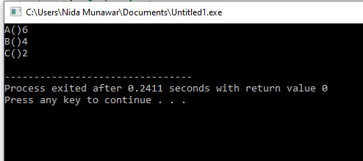
Solution

Slide 84
Case study
Create an Investment class that contains fields to hold the initial value of an investment, the current value,the profit (calculated as the difference between current value and initial value), and the percent profit (the profit divided by the initial value). Include a constructor that requires initial and current values and a display function. Create a House class that includes fields for street address and square feet, a constructor that requires values for both fields, and a display function. Create a HouseThatIsAnInvestment class that inherits from Investment and House. It includes a constructor and a display function that calls the display functions of the parents. Write a main()function that declares a HouseThatIsAnInvestment and displays its values.

Slide 85
Task
Create a class Number that contains the following attributes and methods.
1. -number
2. + getNumber()
3. + setNumber()
Derive two classes from class Number namely,
1. SquareOfNumber
2. CubeOfNumber
Write appropriate functions in the class Square and Cube to calculate the square and cube of any given number.

Slide 86
Solution
class Number {
protected:
int number;
public:
Number(int num) : number(num) {}
int getNumber() {
return number;
}
int returnNumber() {
return number;
}
};
class SquareOfNumber : public Number {
public:
SquareOfNumber(int num) : Number(num) {}
int calculateSquare() {
return number * number;
}
};
class CubeOfNumber : public Number {
public:
CubeOfNumber(int num) : Number(num) {}
int calculateCube() {
return number * number * number;
}
};

Slide 87
Case Study
Create a base class called shape. Use this class to store two double type values that could be used to compute the area of figures. Derive two specific classes called triangle and rectangle from the base shape. Add to the base class, a member function get_data( ) to initialize base class data members and another member function display_area( ) to compute and display the area of figures. Using these three classes, design a program that will accept dimensions of a triangle or a rectangle interactively and display the area. Remember the two values given as input will be treated as lengths of two sides in the case of rectangles and as base and height in the case of triangles and used as follows: Area of rectangle = x * y Area of triangle = ½ * x * y

Slide 88
Case Study
Consider a class BankAccount that has:
Two attributes i.e. accountID and balance
A functions named balanceInquiry() to get information about the current amount in the
account.
Derive two classes from the BankAccount class i.e. CurrentAccount and SavingAccount. Both classes inherit all the attributes and behaviors from the BankAccount class. In addition, followings are required to be the part of both classes:
Appropriate constructors to initialize data fields of base class
A function named amountWithdraw(amount) to withdraw certain amount while taken into account the following conditions
While withdrawing from current account, the minimum balance should not decrease Rs. 5000
While withdrawing from saving account, the minimum balance should not decrease Rs. 10,000.
AmoutDeposit(amount) to deposit amount in the account.
In main () function, create instance of derived class (i.e. CurrentAccount and SavingAccounts)
and invoke their respective functions to test their working.

Slide 89
Case Study
Consider a base class named Employee and its derived classes HourlyEmployee and PermanentEmployee while taking into account the following criteria.
Employee class has two data fields i.e. name (type of string) and empID (of type integer).
Both classes (HourlyEmployee and PermanentEmployee) have an attribute named hourlyIncome.
Both classes (HourlyEmployee and PermanentEmployee) have three argument constructor to initialize the hourlyIncome as well as data fields of the base class.
Class HourlyEmployee has a function named calculate_hourly_income to calculate the income of an employee for the actual number of hours he or she worked. One-hour income is Rs.150.
Similarly, PermanentEmployee class has the function named calculate_income to calculate the income of an employee that gets paid the salary for exact 240 hours, no matter how many actual hours he or she worked. Again, one hour is Rs 150.
Implement all class definition with their respective constructors to initialize all data members
and functions to compute the total income of an employee. In the main() function, create an
instance of both classes (i.e. HourlyEmployee and PermanentEmployee) and test the working
of functions that calculate the total income of an employee.

Slide 90
Case Studey
We want to calculate the total marks of each student of a class in Physics, Chemistry and Mathematics and the average marks of the class. The number of students in the class are entered by the user. Create a class named Marks with private data members 1. roll number 2. name 3.. marks Create three other classes inheriting the Marks class, namely 1. Physics 2. Chemistry 3. Mathematics which are used to define marks in individual subject of each student. Roll number of each student will be generated automatically.

Slide 91
Case study
Create an Investment class that contains fields to hold the initial value of an investment, the current value,the profit (calculated as the difference between current value and initial value), and the percent profit (the profit divided by the initial value). Include a constructor that requires initial and current values and a display function. Create a House class that includes fields for street address and square feet, a constructor that requires values for both fields, and a display function. Create a HouseThatIsAnInvestment class that inherits from Investment and House. It includes a constructor and a display function that calls the display functions of the parents. Write a main()function that declares a HouseThatIsAnInvestment and displays its values.

Slide 92
Home Task
Write a C++ program that has a class named “Person”.
The class has a default constructor that displays “I am a person”.
The class has attributes name, age, nationality, address and CNIC.
The class has an input function that prompts the user to enter all the details. For CNIC, the total number of digits should be exactly 13. If it’s less than 13 or greater display an error message.
The class also has a display function that displays all the details.
Derive a class Employee from Person.
The class Employee has a default constructor that invokes the base class’s constructor and displays “I am an Employee”.
The class has the attributes name of company, company’s location (city), no of years worked.
The class has an input function that prompts the user to enter all the details. It also has a
display function that displays all the details.
Derive a class Manager from Employee.
The class Manager has a default constructor that invokes the base class’s constructor and
displays “I am a Manager”.
The class has an array that contains the names of employee’s who are working under the
manager’s supervision. Input at least five employee’s in the array from the user and display all
these employee’s too.
In the main program, call all the functions and display the details.

